Slide 1


Up n smoke by Michelle Kat Carmen Haritha veethika
Date : 04/16/2024

Slide 2
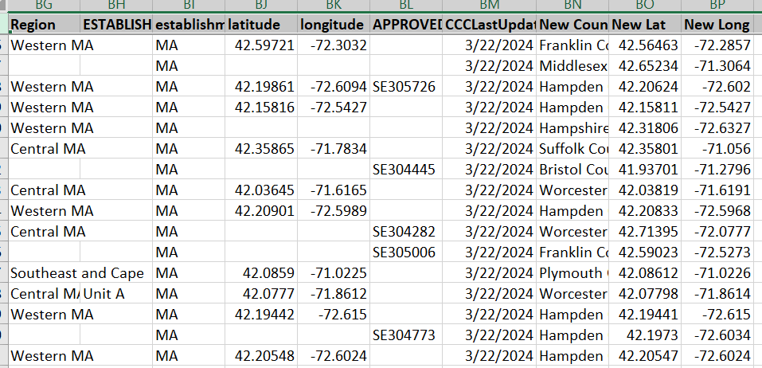
Data Gathering/Cleansing
Data was downloaded from some sites for Legalization for Massachusetts
Files for crime were downloaded from FBI Crime data site
Data was cleansed for Latitude/Longitude and County from geoapify site to get the missing data

Slide 3
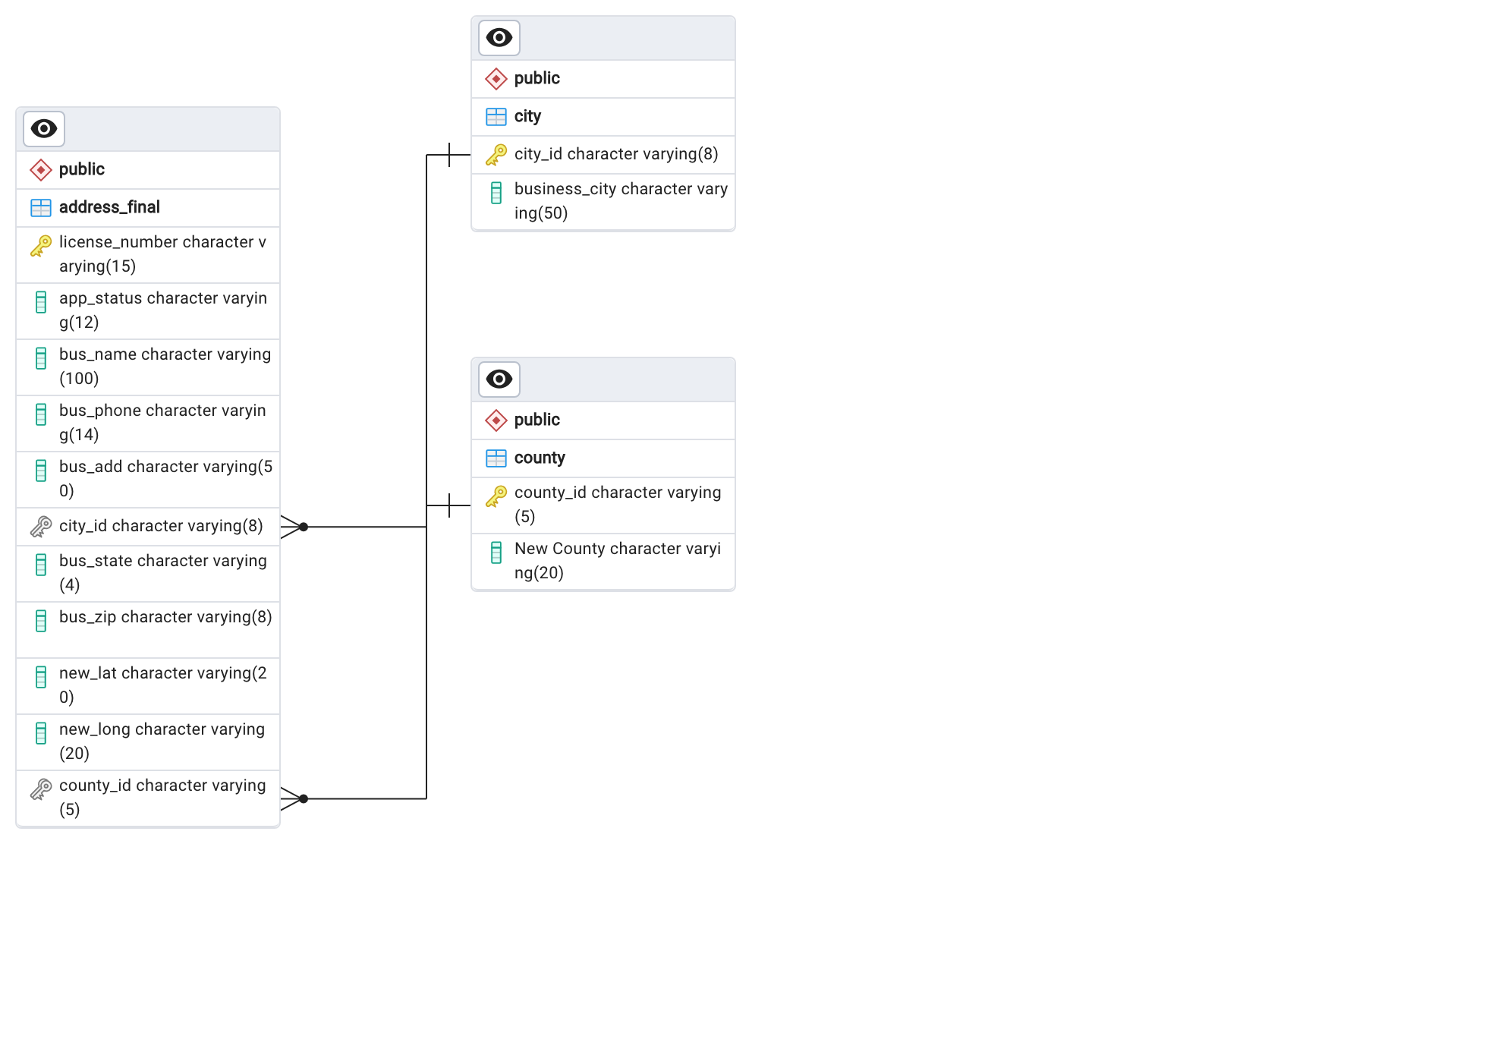
Data in Postgres
Data was updated to have required columns and uploaded to Postgres sql database
Data shows the license number for the business with the City and County and geographical Latitude and longitude

Slide 4
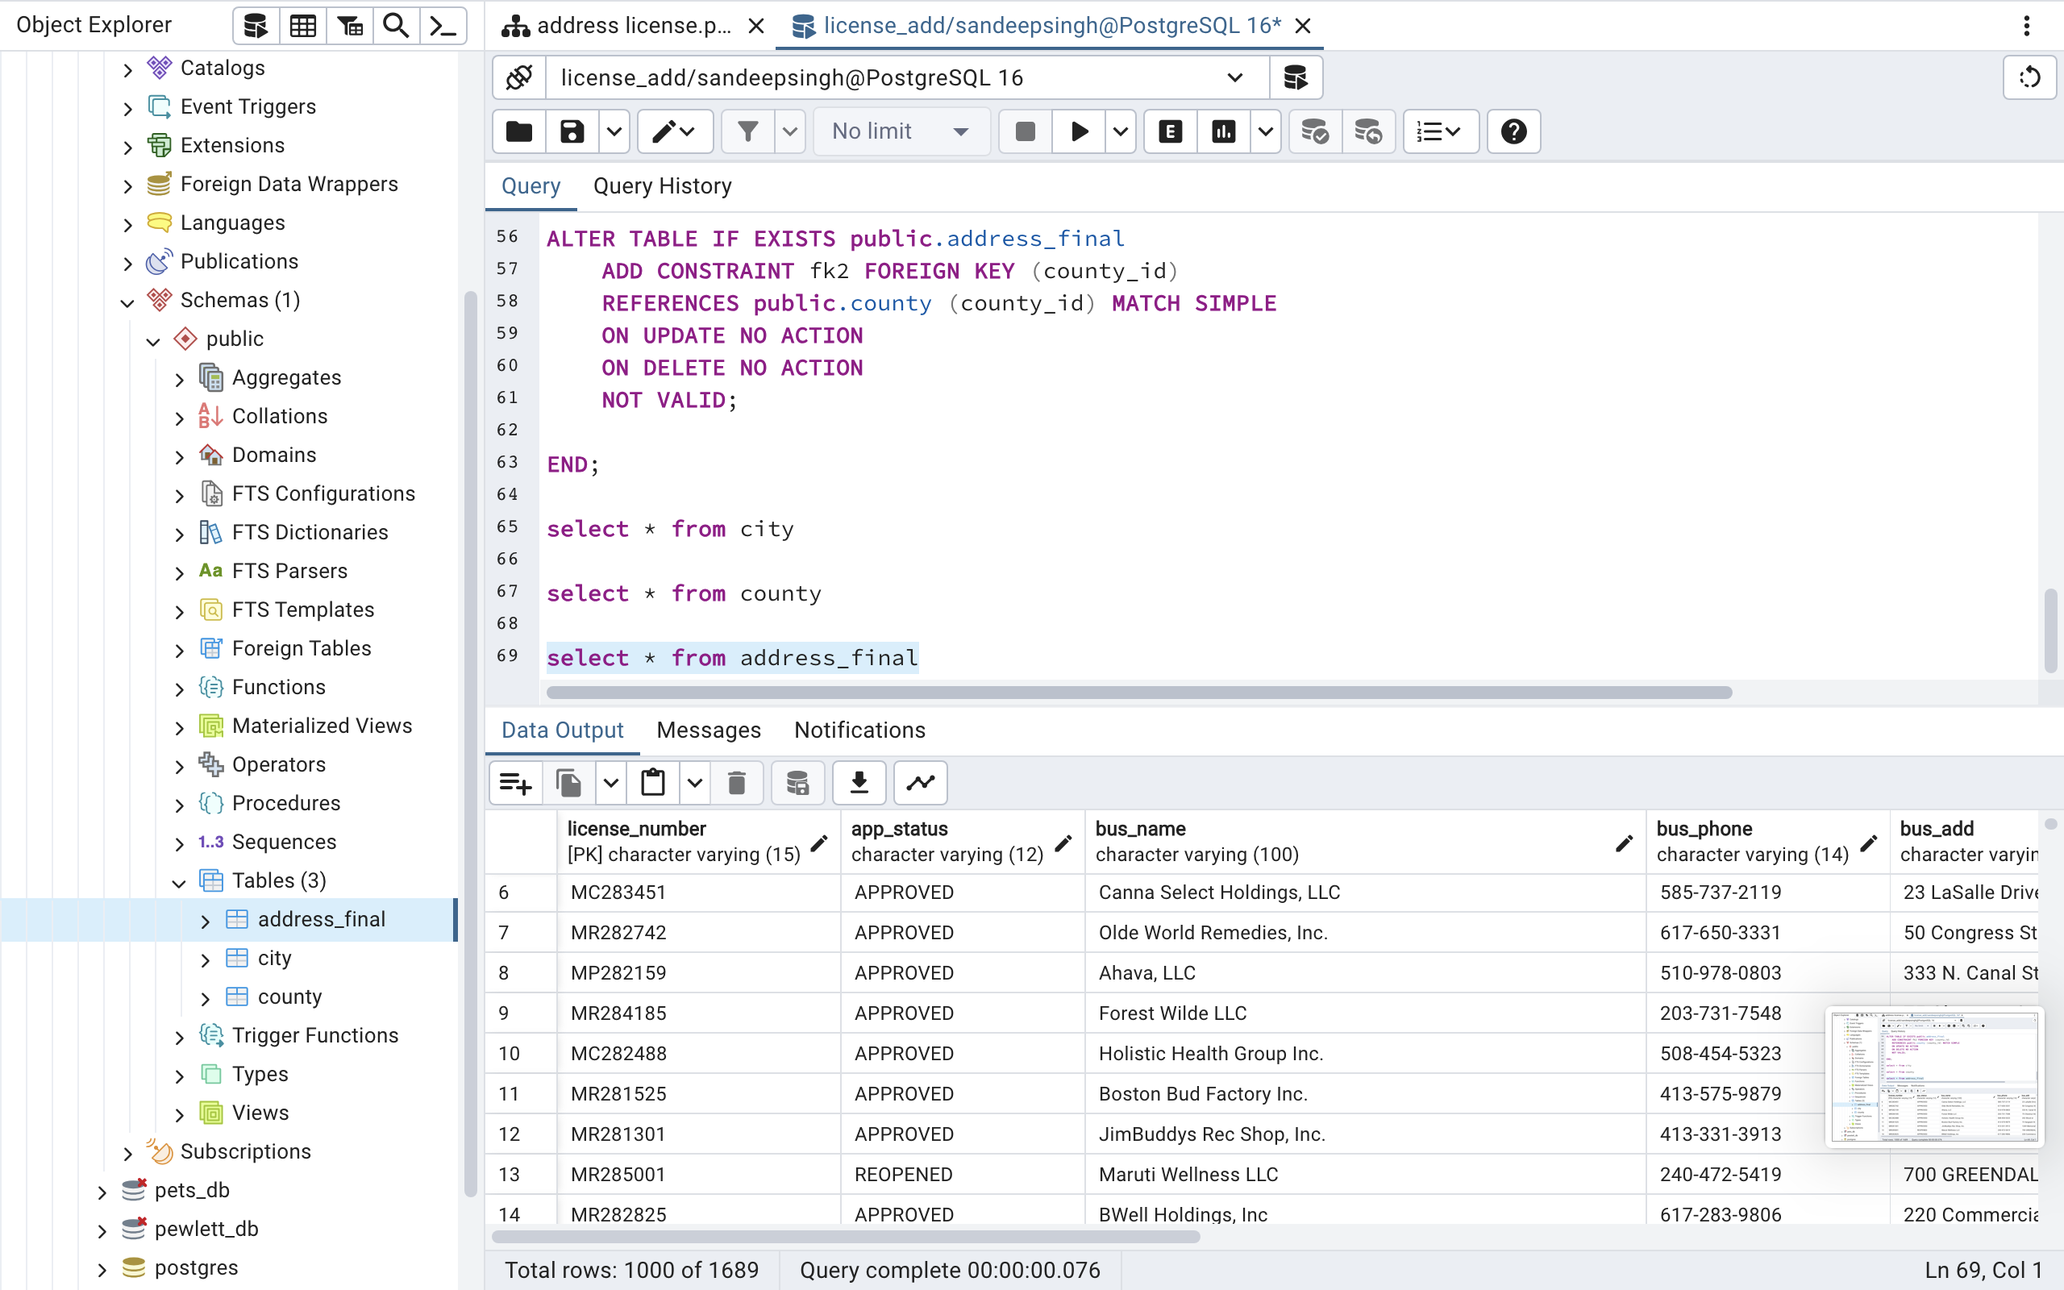
Table Data

Slide 5
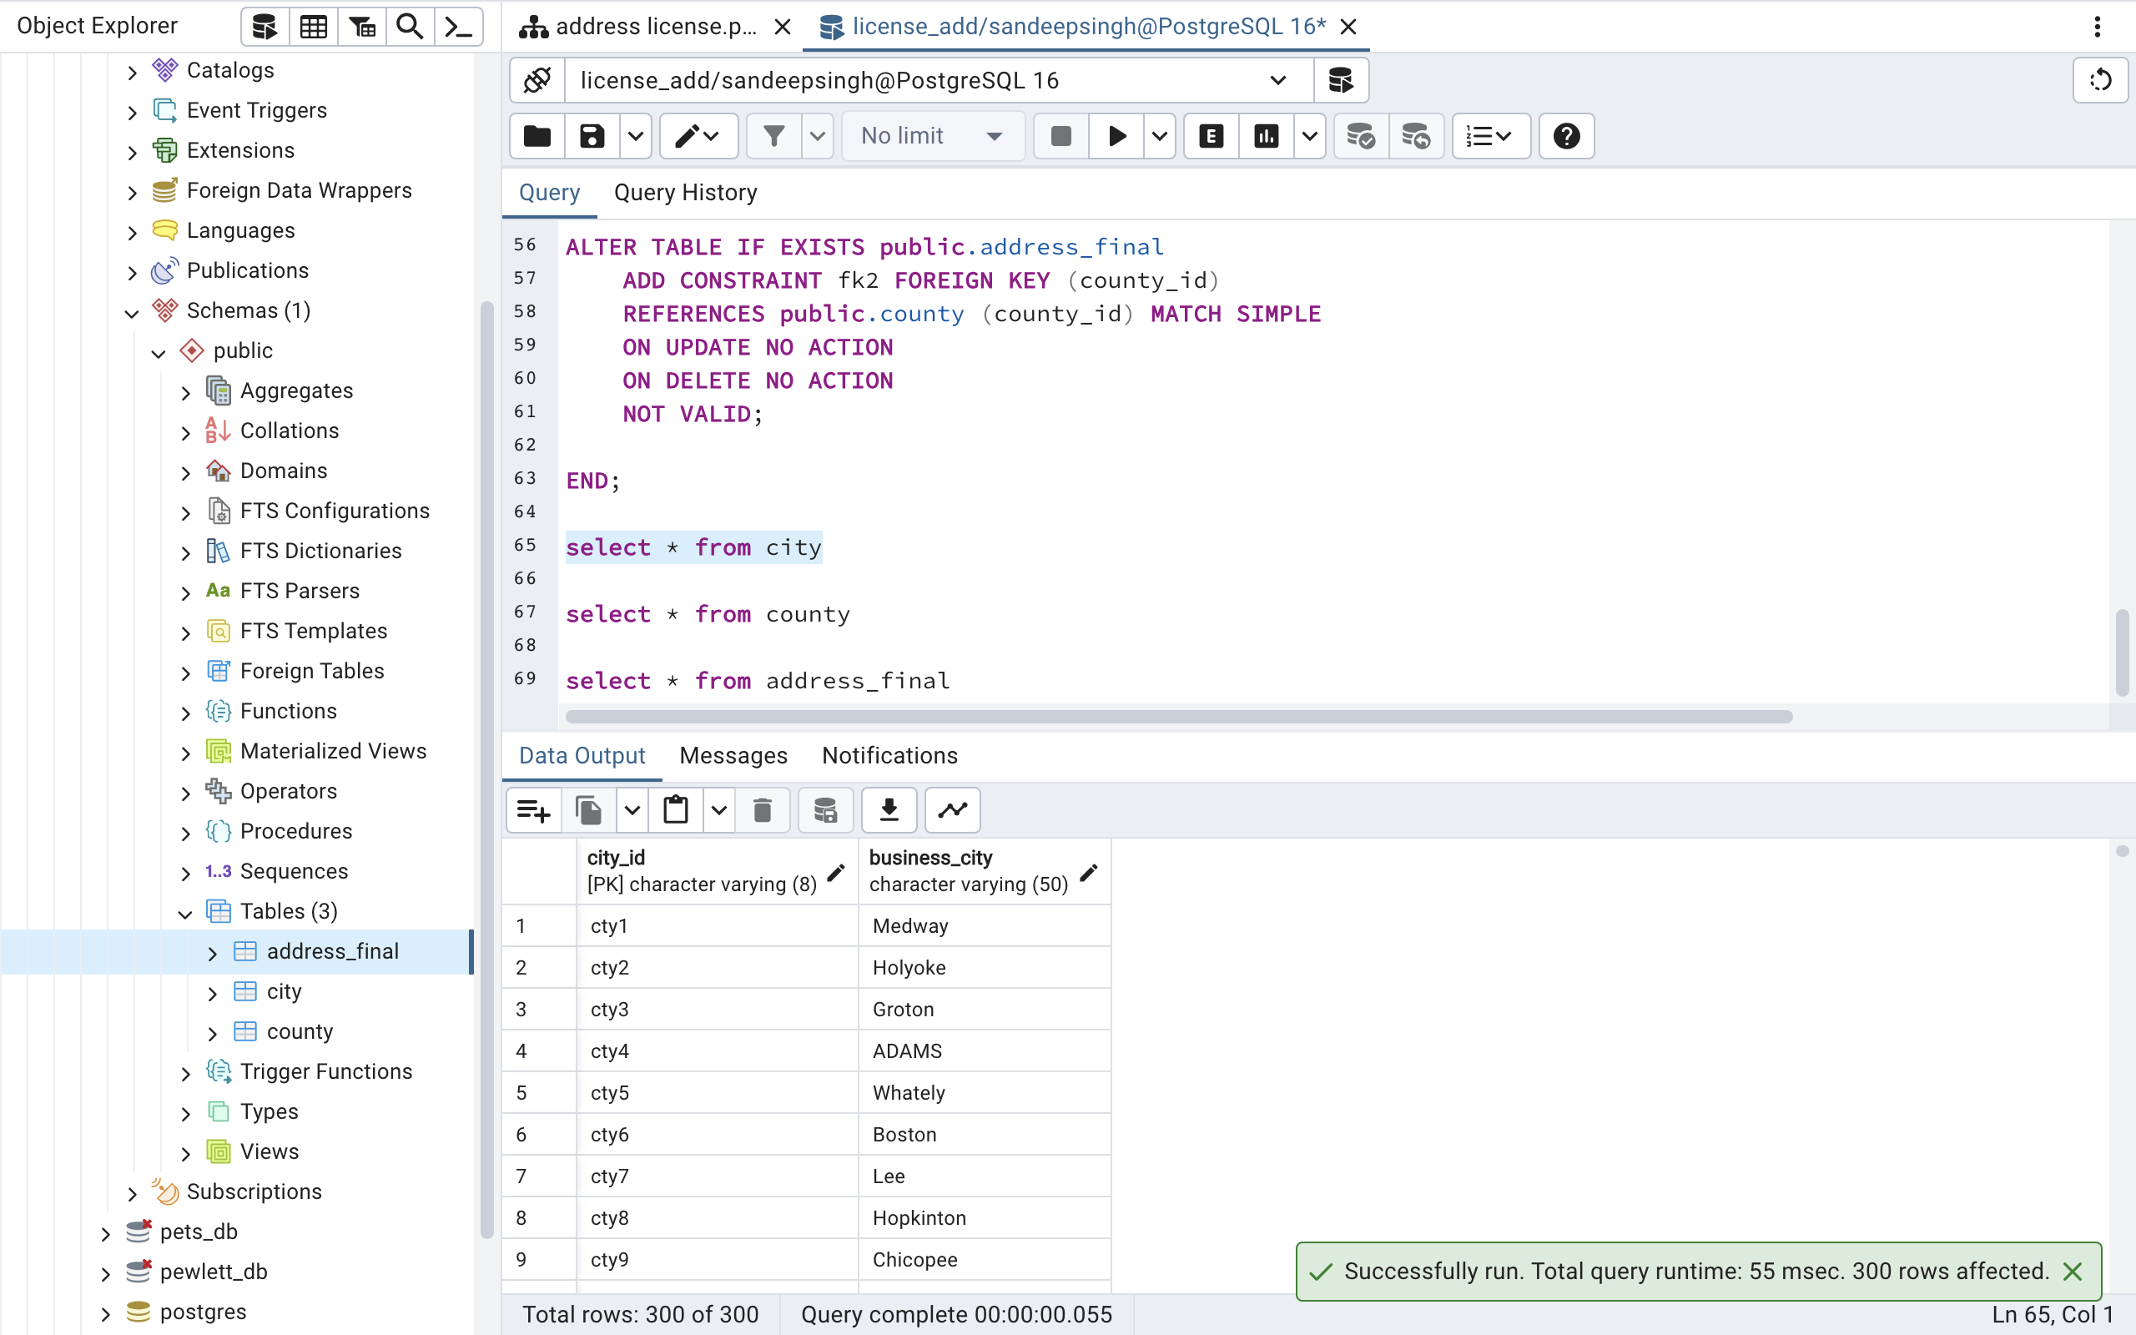
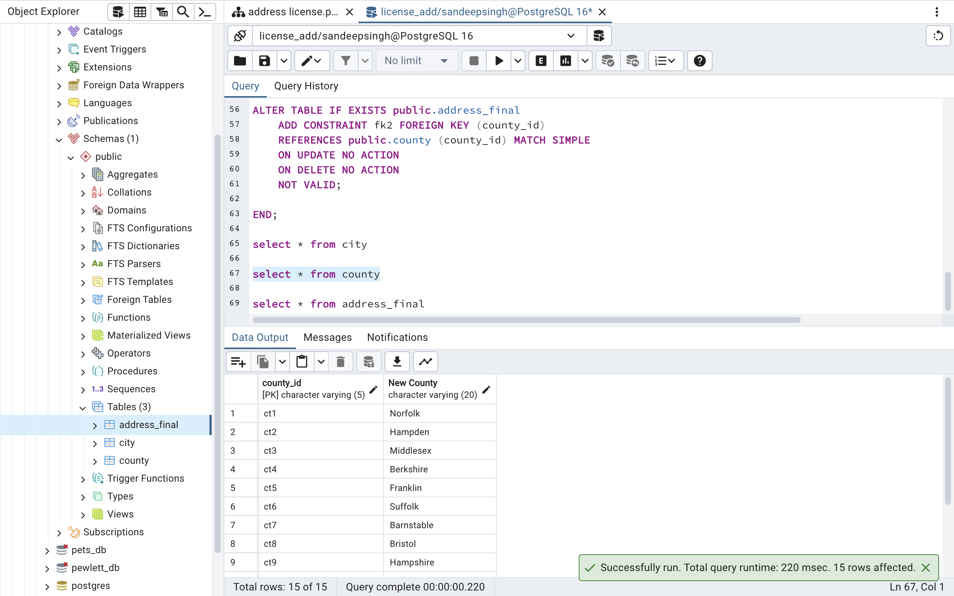
Table Data

